Slide 1


Lumbini Elite SAP GRC Solutions
Mastering Risk, Compliance, and Governance for Future-Ready Enterprises
Company Profile

Slide 2

Who We Are?
Lumbini Elite Solutions is positioned at the forefront of digital transformation, providing cutting-edge SAP services that drive innovation, efficiency, and sustainability for global enterprises.
Our comprehensive offerings—from S4HANA implementations to advanced cloud platforms like SAP BTP—enable organizations to harness the full potential of Industry 4.0.
With a proven track record, scalable solutions, and an experienced leadership team, we’re primed for rapid global expansion and significant revenue growth.
01
Mission:
To accelerate the digital transformation of global enterprises through innovative SAP services and technologies.
02
Vision:
To be a global leader in delivering cutting-edge technology solutions that enable organizations to achieve excellence.
03
Core Values:
Innovation, Integrity, Customer-Centricity, Collaboration, and Continuous Improvement.

Slide 3



Focus Industry Verticals
Utilities
Renewable Energy
E-Governance
AFS
Pharmaceuticals
Manufacturing
Consumer Goods and Retail

Slide 4

Our SAP GRC Expertise
SAP Change management: SAP R/3 change management and control and the related policies, processes, training, and implementation of the change control system for managing SAP R/3 system changes - both from a business and technology perspective. In the process, we manage and drive your SAP R/3 implementations toward “Governance”
SAP Security & Authorizations: SAP R/3 security, authorizations, access control, and related process, policies, segregation of duties, design, review, audit, and implementation for very small to large multi-location, multi-language, multi-region SAP R/3 landscapes – both from a project perspective and from enhancement-support perspective. In the process, we have seen these implementations grow in size and complexity and transition from the initial version to the latest releases. In the process, we manage and mitigate the access “Risk”
  SAP - Security & access policies
  SAP - User access and provisioning process
  SAP - User de-provisioning process
  SAP - Role creation process
  SAP - Role enhancement process
  SAP - Role design documents
  SAP - Policy and processes for managing background jobs for security
  SAP - Periodic security audit review policies and processes
  SAP Security - Issue resolution process and supporting escalation processes.
  SAP Security - Super-user access policies and process around exception authorizations
Compliance: Regulatory compliance of various industries and agencies.

Slide 5
  SAP GRC (Governance, Risk & Compliance)
Risk Management | Access Control | Process Control
Formal integration of risk management with strategy | Segregation of duties | Automated control and transaction monitoring to evaluate compliance effectiveness and business process acceptability
Repeatable framework to analyze and mitigate risk | Fraud, safeguard of assets | Configuration
Continuously monitor key risk indicators across strategic objectives | User access management | Master Data
 | Compliance | Business transactions

Slide 6
  Our GRC Solutions
SAP Security & Authorizations: SAP R/3, BI security, authorizations, access control, and related process, policies, segregation of duties, design, review, audit, and implementation for very small to large multi-location, multi-language, multi-region SAP R/3 landscapes – both from project perspective and from enhancement-support perspective.
BI Security by creating Analysis Authorizations using RSECADMIN, and running the reports for different users through RSECADMIN.
Expertise in implementing GRC AC 10.1 components such as ARM, ARA, and Emergency Access.
Expertise in SAP security in terms of creating (users, profiles & roles), and assigning (profiles, roles, authorization) to users using Profile Generator [PFCG].
We have good knowledge and work experience in Virtual authorization
The team has Worked extensively on Analysis Authorization
Maintaining SLAs for all the issues
User management defining multilevel security privileges for the users.

Slide 7
Key integration benefits of the SAP GRC solutions
Master data
  Organizations can be shared between SAP GRC Process Control, SAP GRC Risk Management and SAP GRC Access Control. Some organization data may be shared, and other data may be specific to a single application; Controls may be shared between SAP GRC Process Control and SAP GRC Access Control.
  There is application-specific information for SAP GRC Process Control and SAP GRC Access Control applications. The access to this data is controlled by the user’s authorizations.
Integration of SAP GRC Process Control with Access Control
  SAP GRC Process Control is integrated with the Access Risk Analysis component in SAP GRC Access Control to monitor Segregation of Duties (SoD) violations;
  Controls in SAP GRC Process Control can be used as mitigation controls in SAP GRC Access Control and vice versa;
  Processes in SAP GRC Process Control can be used as business processes in SAP GRC Access Control.
  The shared Risk Catalog is by SAP GRC Process Control and SAP GRC Risk Management. There is application-specific information for SAP GRC Process Control and SAP GRC Access Control applications

Slide 8
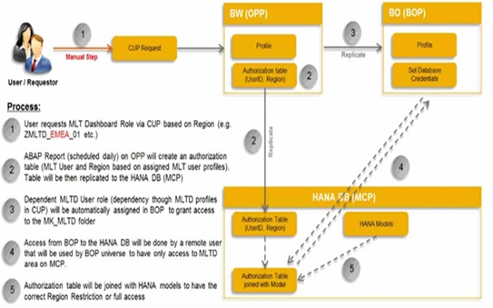
Projects & Case Studies –I - MLT (Marketing Leadership Team)
In this Project BI team developed a mobile (iPad) compatible BI solution which allowed the MLT (Marketing Leadership Team) to easily access and understand year to date KPI and results.
This solution is now embedded in the performance management process for the Marketing organization.
There is a need to automate the data-access process and streamline the information access through the dashboard
We delivered Security and Modelling concept based on HANA DB
Our Team worked on Analyzing the proponents and Stakeholders, Build Security Concept for Role based access to System. Designed Roles, Profiles, Analysis Authorizations using SAP GRC 10.0 ARM and SAP BI 7.3

Slide 9
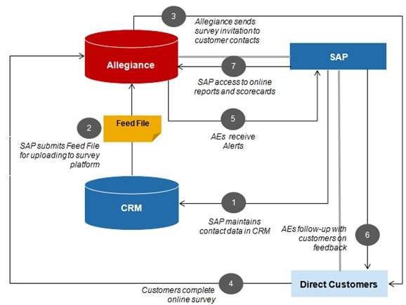
Projects & Case Studies –II (Global Customer Experience)
The SAP Global Customer Experience (GCE) goal is to provide timely, understandable, and actionable insight into the state of customer / partner satisfaction and loyalty and its impact on SAP‘s growth.
In this project the entire security concept which was based on profiles were replaced with new security based on roles.
We introduce SAP IDM for better User management
This is inline with the new Authorization concept from SAP called Virtual Authorization.
Provided Data access restriction on top of views by creating Analytical Privileges
Worked on Profile Administration Process(PAP) for Roles availability in ARM so that end user can request these roles through CUP

Slide 10
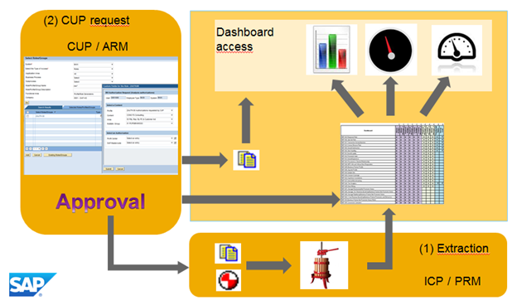
Projects & Case Studies –III (Intellectual Property Management Reporting )
Intellectual Property Management Reporting Project is Based on IPM@SAP.
It was required to provide full visibility and analytical support to all relevant SAP Development Units (Global IP department, Global F&A TIP, etc.) around available IP, 3rd Party and Opensource technologies via searchable IP Assets Database and related analytic dashboards
Here BI security is based on 4 main profiles which can control the entire flow
We designed the Security concept to understand the Business Requirement. Designed the profiles with Analysis Authorizations and assigned to required users
Worked on Analysis Authorization based on Exit variables. Used GRC tools like CUP and ARM to streamline the approval process.

Slide 11
Our Engagement Models
Lumbini offers three service delivery models, which clients can choose from depending on the level of control/oversight that the clients would like. This typically depends on the nature of the engagement, the lifecycle of the application, and clients goals.
Client controls the project while engaging Lumbini consultants for specific services exclusively or among multiple vendor partners, each meeting their specific project requirements
CONSULTING
Client Control / Management
CONSULTING
Client and Lumbini both have acute insight on the engagement. Client is responsible for engagement planning and user coordination, while the Lumbini team is responsible for deliverables and resource planning
CO-SOURCING
CO-SOURCING
OUTSOURCING
Lumbini is given the control as the outsourced vendor partner. Engagement is usually managed through a set of service level agreements (SLAs).
OUTSOURCING
Engagement Value / Scalability

Slide 12






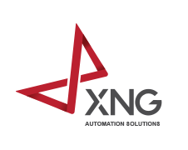


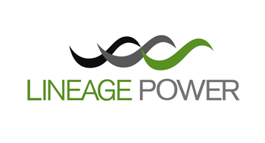




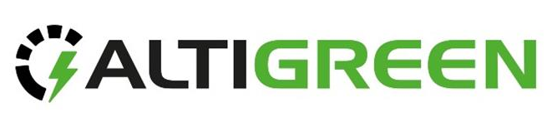









OUR CLIENTS & PARTNERS

Slide 13

WHY LUMBINI ELITE ?
Company Overview and Expertise
12+ years of experience, focusing on SAP, PLM, and MES Product Suites, along with expertise in new Dimension areas like DevOps, Analytics, Mobility, Cloud, and IoT.
Certifications and Partnerships
ISO-9001:2015/ISO-14001:2015 certifications, as well as its strong associations with German software product companies like SAP, Microsoft (as a Bizspark Member), and Siemens (as a consulting partner for TeamCenter).
Geographical Presence
Presence in Bangalore, Jharkhand (Ranchi), Delhi (Noida), and Qatar(Middle East) highlighting its strategic location in the IT hub of India and its ability to cater to clients across different regions.

Slide 14
GET IN TOUCH WITH US
Thank
You
CORPORATE OFFICE
DEVELOPMENT CENTER
#7, SJR Eternity, Phase 1
Kodigehalli Road, Hoodi
Bangalore, Karnataka, India.
Pincode-560048
1102 & 1103, 1st Floor, A - Block,
Ardente Office One, Hoodi,
Bangalore, Karnataka, India.
Pincode-560048
www.lumbinielite.com
Email:- info@lumbinielite.com

